Slide 1
MINI PROJECT
PRESENTED BY:-
MAHYAVANSHI ARPIT(IU1841230027)

Slide 2
CUSTOMER SEGMENTATION ANALYSIS

Slide 3
INDEX
DEFINITION
BASIS AND TYPES
WHY SEGMENTATION MATTERS?
APPROACHES
EXAMPLE
BENEFITS
ANALYSIS
STEPS
CLUSTERING

Slide 4
WHAT IS CUSTOMER SEGMENTATION?
Customer Segmentation is the subdivision of a market into discrete customer groups that share similar characteristics. Customer Segmentation can be a powerful means to identify unsatisfied customer needs.
That division is based on customers having similar enough:
Needs, i.e., so that a single whole product can satisfy them.
Buying characteristics, i.e., responses to messaging, marketing channels, and sales channels, that a single go-to-market approach can be used to sell to them competitively and economically.

Slide 5
BASIS OF CUSTOMER SEGMENTATION :-
Demographic information
Geographical information
Psychographics
Behavioral data

Slide 6
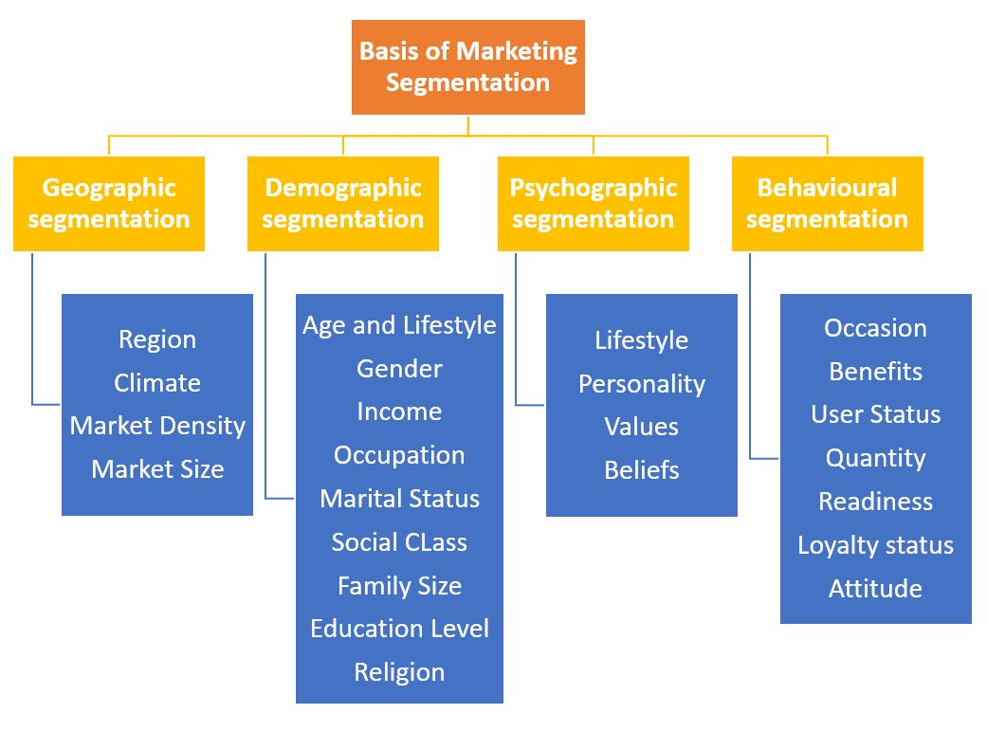

Slide 7
WHY SEGMENTATION MATTERS?
Customer Segmentation can be a powerful means to identify unsatisfied customer needs. This technique can be used by companies to outperform the competition by developing uniquely appealing products and services.
Focuses The Entire Team On Same Target
Gives You A Touchstone For Making Decisions
Prioritizes Where To Invest Your Resources
Increases Customer Retention
Identifies New Market Opportunities

Slide 8
APPROACHES TO CUSTOMER SEGMENTATION

Slide 9
3 main approaches:-
A priori segmentation
Needs-based segmentation
Value-based segmentation

Slide 10
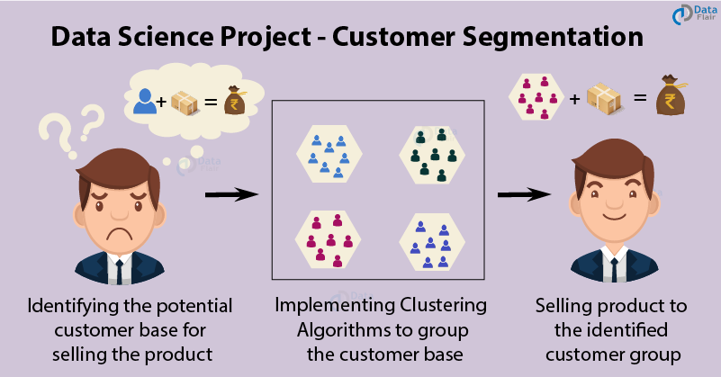

Slide 11
What Are Companies That Use Segmentation?
Numerous types of businesses use customer segmentation to optimize their ability to sell to a wide variety of consumers, including:
Skincare, Haircare, And Beauty Product Manufacturers
Car Companies
Clothing And Apparel Suppliers
Banks And Other Financial Institutions
Television Networks And Media Outlets

Slide 12
Benefits of Customer Segmentation
(1)
Improving your whole product
(2)
Focusing your marketing message
(3)
Allowing your sales organization to pursue higher percentage opportunities
(4)
Getting higher quality revenues

Slide 13
ANALYSIS:-
For a technology company moving from the startup stage to the expansion stage, that often means abandoning a non-discriminatory, “take every customer we can get” approach, and replacing it with a far more targeted, best current customer segment strategy.
Executing a customer segmentation research process is the first step toward helping a growing company make that transition. Ultimately, best current customer segmentation can help your business better define its ideal customers, identify the segments that those customers belong to, and improve overall organizational focus.

Slide 14
STEPS:-
Step 1: Setting Up Your Customer Segmentation Project
Step 2: Analyzing Customer Data
Step 3: Data Collection
Step 4: Analysis and Prioritization
(CLUSTERING)
Step 5: Presenting and Incorporating Feedback

Slide 15
NOW,BEFORE ANALYSIS LET’S UNDERSTAND CLUSTERING!

Slide 16
CLUSTERING:-
Clustering is a task of dividing the data sets into a certain number of clusters in such a manner that the data points belonging to a cluster have similar characteristics.
In other words, the clusters are regions where the density of similar data points is high. It is generally used for the analysis of the data set, to find insightful data among huge data sets and draw inferences from it.

Slide 17
TYPES OF CLUSTERING METHODS:-
Density-Based Clustering
DBSCAN (Density-Based Spatial Clustering of Applications with Noise)
OPTICS (Ordering Points to Identify Clustering Structure)
Hierarchical Clustering
Fuzzy Clustering
Partitioning Clustering

Slide 18
K-means algorithm:-
It is an iterative algorithm that divides the unlabeled dataset into k different clusters in such a way that each dataset belongs only one group that has similar properties.
The main aim of this algorithm is to minimize the sum of distances between the data point and their corresponding clusters.
The k-means clustering algorithm mainly performs two tasks:
Determines the best value for K center points or centroids by an iterative process.
Assigns each data point to its closest k-center. Those data points which are near to the particular k-center, create a cluster.

Slide 19
ALGORITHM:-
Step-1: Select the number K to decide the number of clusters.
Step-2: Select random K points or centroids. (It can be other from the input dataset).
Step-3: Assign each data point to their closest centroid, which will form the predefined K clusters.
Step-4: Calculate the variance and place a new centroid of each cluster.
Step-5: Repeat the third steps, which means reassign each datapoint to the new closest centroid of each cluster.
Step-6: If any reassignment occurs, then go to step-4 else go to FINISH.
Step-7: The model is ready.

Slide 20
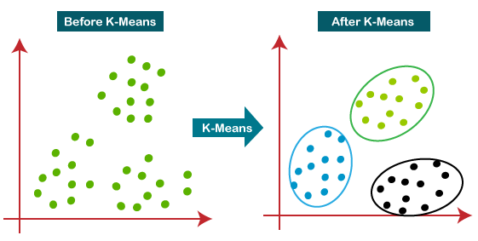
EXAMPLE:-

Slide 21
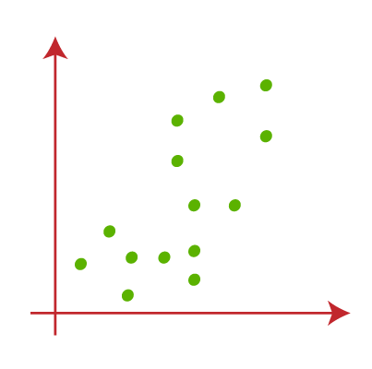
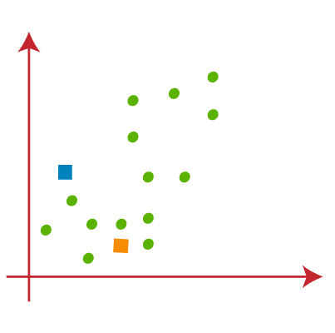
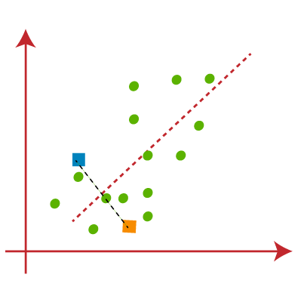
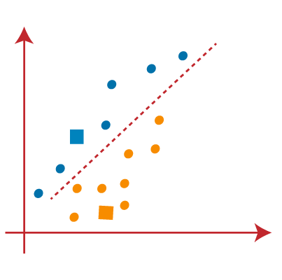
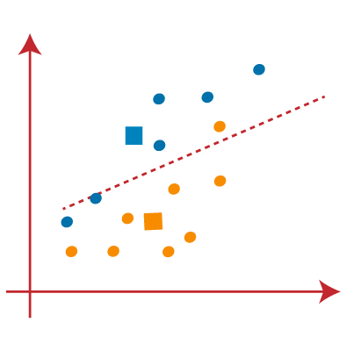

Slide 22
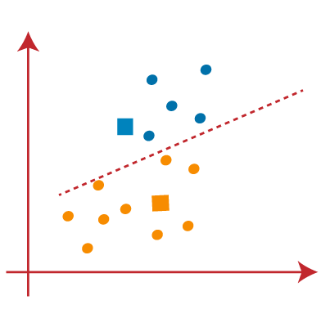
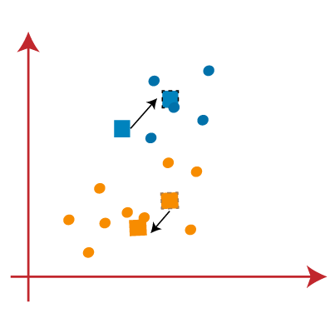
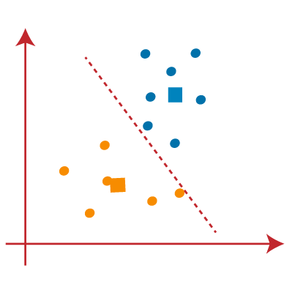
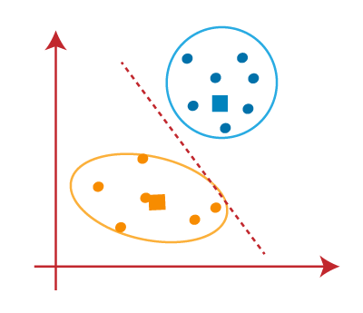
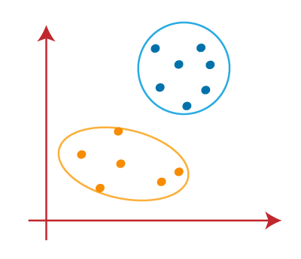

Slide 23
How to choose the value of "K number of clusters" in K-means Clustering?
While working with clusters, you need to specify the number of clusters to use. You would like to utilize the optimal number of clusters.
three popular methods –
Elbow method
Silhouette method
Gap statistic

Slide 24
IMPLEMENTATION

Slide 25
THANK YOU

